Slide 1
Naïve Bayes
Geoff Hulten

Slide 2
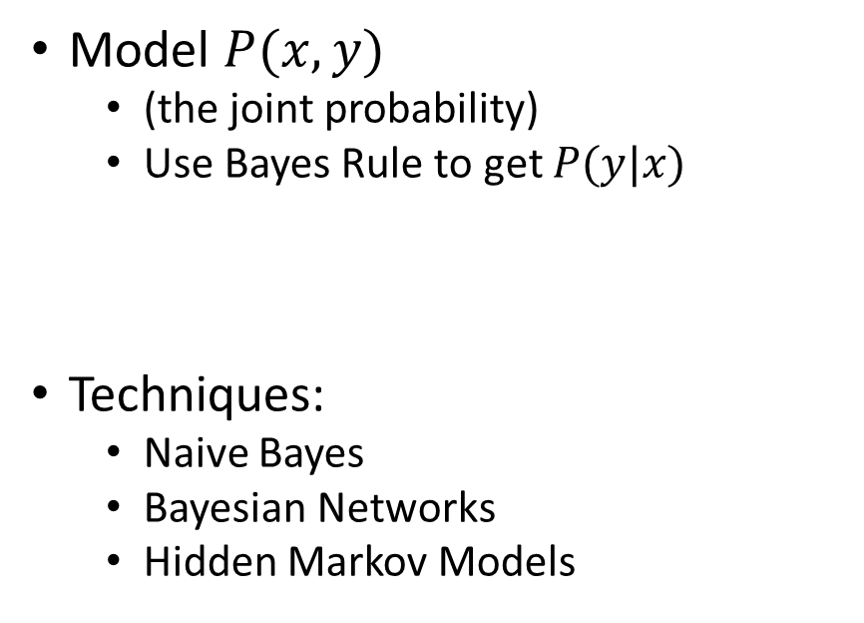
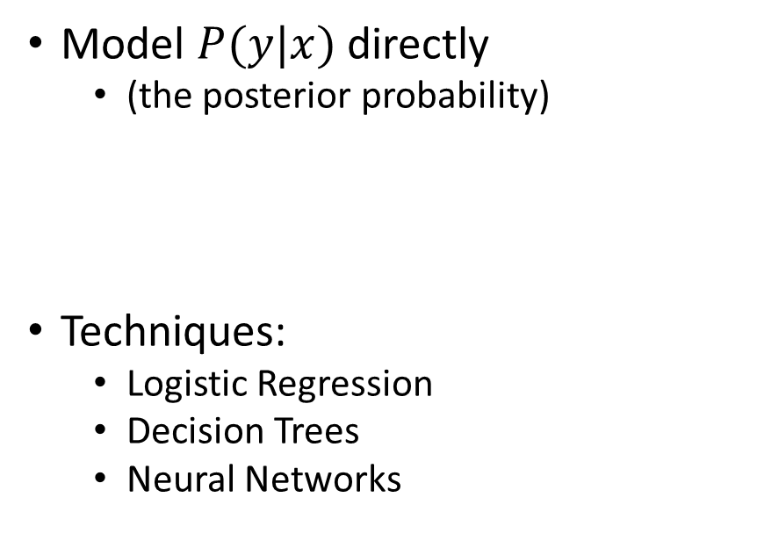
Two Approaches to Supervised Learning
Discriminative
Generative
Model $P(y|x)$ directly
  (the posterior probability)
Techniques:
  Logistic Regression
  Decision Trees
  Neural Networks
Model $P(x,y)$
  (the joint probability)
  Use Bayes Rule to get $P(y|x)$
Techniques:
  Naive Bayes
  Bayesian Networks
  Hidden Markov Models
https://ai.stanford.edu/~ang/papers/nips01-discriminativegenerative.pdf

Slide 3


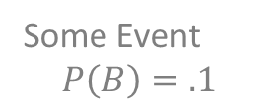

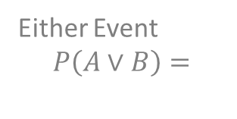
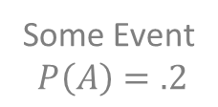


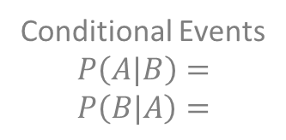




Some Probability Concepts
Both Events
$$P\left(A⋀B\right)=$$
$$0$$
All Possibilities
P(*) = 1.0
$$∘$$
A
Sample a point:
If out of region: $¬A$ occurred
If in region: $A$ occurred
Either Event
$$P\left(A∨B\right)=$$
$$.3$$
Probability A occurs given that we know B occurred
Some Event
$$P\left(A\right)=.2$$
$$x_{2}$$
B
Conditional Events
$$P\left(A|B\right)=$$
$$P\left(B|A\right)=$$
$$0$$
$$0$$
Some Event
$$P\left(B\right)=.1$$
$$x_{1}$$

Slide 4

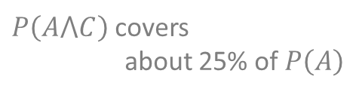









Some Probability Concepts
Events
$$P\left(A\right)=.2$$
$$P\left(B\right)=.1$$
$$P\left(C\right)=.1$$
Both Events
$$P\left(A⋀B\right)=$$
$$P\left(A⋀C\right)≈$$
$$0$$
$$.05$$
$$P\left(A⋀C\right)≈.05$$
A
Either Event
$$P\left(A∨B\right)=$$
$$P\left(A∨C\right)≈$$
$$P\left(A\right)=.2$$
$$.3$$
$P\left(A⋀C\right)$ covers
about 25% of $P\left(A\right)$
$$.25$$
C
$$x_{2}$$
B
Conditional Events
$$P\left(A|B\right)=$$
$$P\left(B|A\right)=$$
$$P\left(A|C\right)≈$$
$$P\left(C|A\right)≈$$
$$0$$
$$0$$
$$.5$$
$$.25$$
$$x_{1}$$

Slide 5
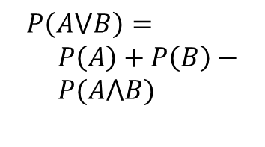

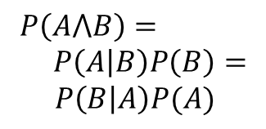


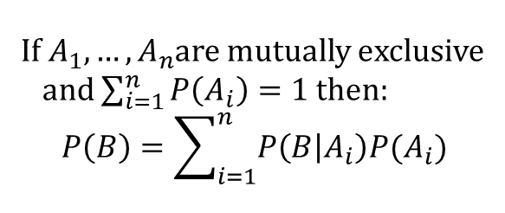
Basic Rules of Probability
$$A_{3}= ¬(A_{1}⋁A_{2})$$
Product Rule
Sum Rule
Theorem of Total Probability
A
B
A
B
$$A_{1}$$
$$A_{2}$$
B
Don’t
Double
Count
$$P\left(A⋀B\right)= \\ P\left(A | B\right)P\left(B\right)=$$
$P\left(B | A\right)P(A)$
$$P\left(A⋁B\right)= \\ P\left(A\right)+P\left(B\right)− \\ P(A⋀B)$$
If $A_{1}, …,A_{n}$are mutually exclusive
and $\sum_{i=1}^{n}{P\left(A_{i}\right)=1}$then:
$$P\left(B\right)=\sum_{i=1}^{n}{P\left(B | A_{i}\right)P(A_{i})}$$

Slide 6

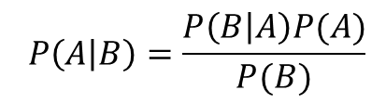
Bayes’ Theorem
Product Rule
Bayes’ Theorem
A
B
$$P\left(A⋀B\right)=P\left(A | B\right)P\left(B\right)=P\left(B | A\right)P(A)$$
$$P\left(A | B\right)P\left(B\right)=P\left(B | A\right)P(A)$$
$$P\left(A | B\right)=\frac{P\left(B | A\right)P(A)}{P(B)}$$

Slide 7
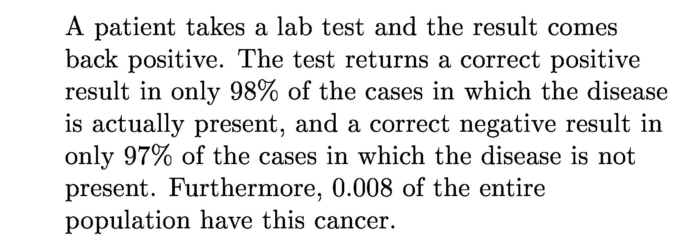
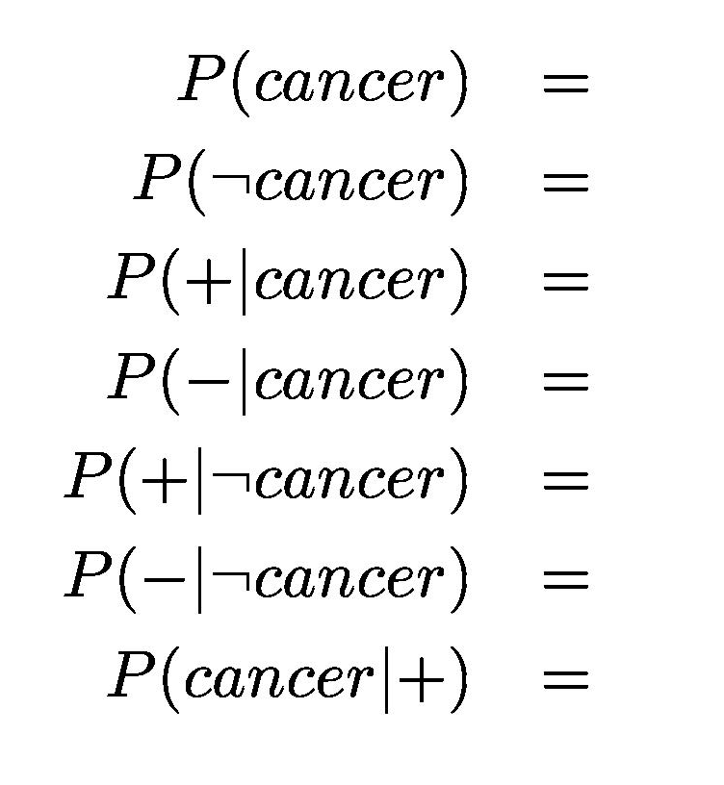





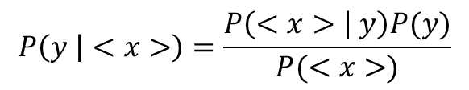

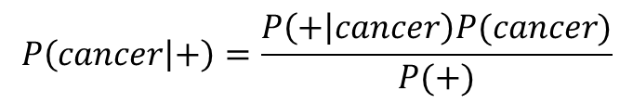
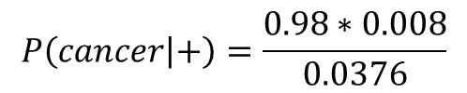

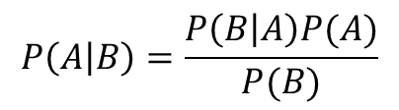
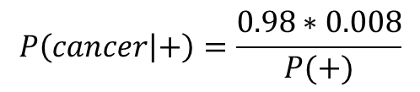
Example of using Bayes Theorem
0.008
$$P\left(A | B\right)=\frac{P\left(B | A\right)P(A)}{P(B)}$$
0.992
0.98
0.02
$$P\left(cancer | +\right)=\frac{P\left(+ | cancer\right)P(cancer)}{P(+)}$$
0.03
$$P\left(+ | cancer\right)=0.98$$
0.97
??
$$P\left(y | <x>\right)=\frac{P\left(<x> | y\right)P(y)}{P(<x>)}$$
$$P\left(cancer\right)=0.008$$
$$P\left(− | cancer\right)=0.02$$
$$P\left(cancer | +\right)=\frac{0.98∗0.008}{P(+)}$$
$$P\left(+ | ¬cancer\right)=0.03$$
$$P\left(cancer | +\right)=\frac{0.98∗0.008}{0.0376}$$
Theorem of total probability
$$P\left(cancer | +\right)=.208$$
$$P\left(+\right)$$
$$P\left(+\right)=P\left(+ | cancer\right)P\left(cancer\right)+P\left(+ | ¬cancer\right)P(¬cancer)$$
$$P\left(+\right)=0.98 ∗0.008 +0.03 ∗ 0.992$$
$$P\left(+\right)=0.0376$$

Slide 8
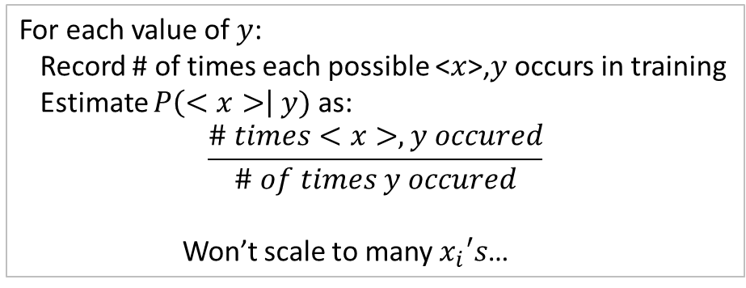

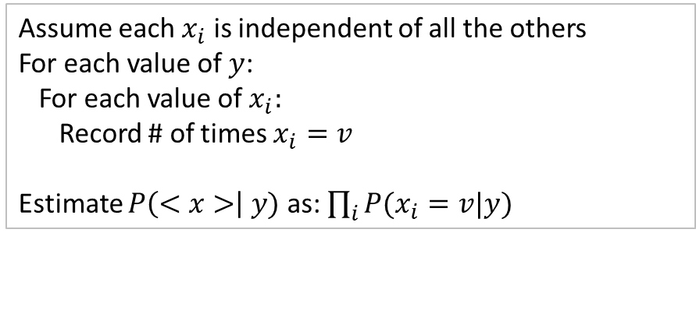
Naïve Bayes
For each value of $y$:
Record # of times each possible <$x$>,$y$ occurs in training
Estimate $P\left(<x>\right| y)$ as:
$$\frac{\# times<x>, y occured}{\# of times y occured}$$
Won’t scale to many $x_{i}′s$…
$$y=\underset{y_{j}∈Y}{argmax}{\frac{P\left(<x>\right|y_{j}) P(y_{j})}{P(<x>)}}$$
$$y=\underset{y_{j}∈Y}{argmax}{P\left(<x>\right|y_{j}) P(y_{j}) }$$
$$y=\underset{y_{j}∈Y}{argmax}{P(y_{j})\prod_{i}{P(x_{i}|y_{j})} }$$
Assume each $x_{i}$ is independent of all the others
For each value of $y$:
For each value of $x_{i}:$
Record # of times $x_{i}=v$
Estimate $P\left(<x>\right| y)$ as: $\prod_{i}{P(x_{i}=v|y)}$
Independence
Assumption

Slide 9



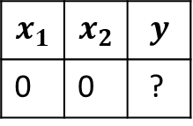


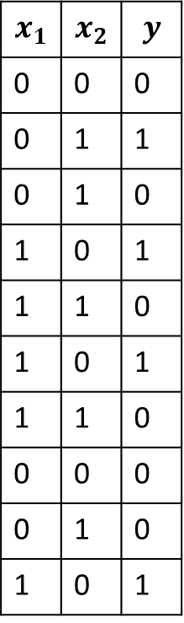

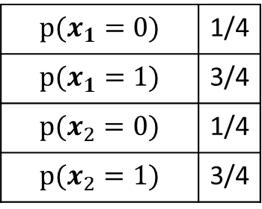


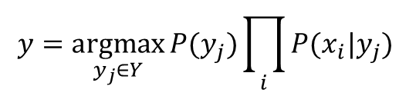
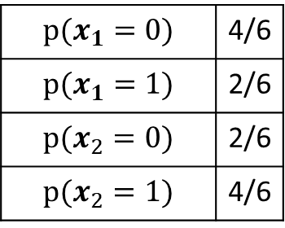

Naïve Bayes Example
$$y=\underset{y_{j}∈Y}{argmax}{P(y_{j})\prod_{i}{P(x_{i}|y_{j})} }$$
$$y=0$$
$$Training Data$$
$$p(x_{1}=0)$$ | 4/6
$$p(x_{1}=1)$$ | 2/6
$$p(x_{2}=0)$$ | 2/6
$$p(x_{2}=1)$$ | 4/6
$$x_{1}$$ | $$x_{2}$$ | $$y$$
0 | 0 | 0
0 | 1 | 1
0 | 1 | 0
1 | 0 | 1
1 | 1 | 0
1 | 0 | 1
1 | 1 | 0
0 | 0 | 0
0 | 1 | 0
1 | 0 | 1
$$x_{1}$$ | $$x_{2}$$ | $$y$$
0 | 0 | ?
$$y=0$$
$$1 \sim P\left(y=1\right)P\left(x_{1}=0|y=1\right)P(x_{2}=0|y=1)$$
$$y=1$$
$$1 \sim 0.4 ∗ 0.25 ∗ 0.25$$
$$p(x_{1}=0)$$ | 1/4
$$p(x_{1}=1)$$ | 3/4
$$p(x_{2}=0)$$ | 1/4
$$p(x_{2}=1)$$ | 3/4
$$1 \sim .025$$
0 $\sim P\left(y=0\right)P\left(x_{1}=0|y=0\right)P(x_{2}=0|y=0)$
0 $\sim 0.6 ∗ 0.66 ∗ 0.33$
0 $\sim .13$
$$p(y=0)$$ | 6/10
$$p(y=1)$$ | 4/10

Slide 10
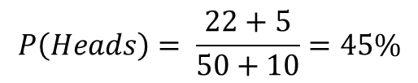
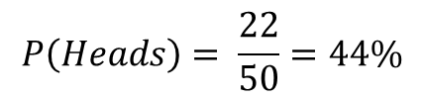

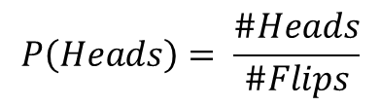
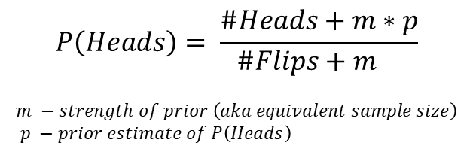
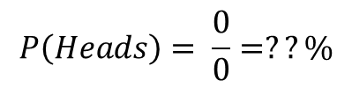
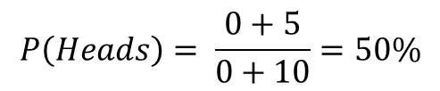
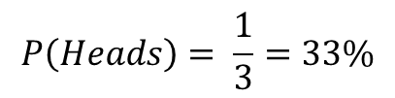
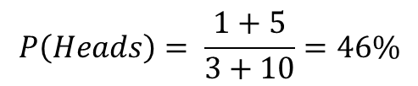
Quick Note about MLE vs MAP
Maximum Likelihood Estimation (MLE)
Estimate probability from observations of data
Maximum A Posteriori (MAP)
Estimate probability from data and prior assumptions
$$P\left(Heads\right)= \frac{\#Heads}{\#Flips}$$
$$P\left(Heads\right)= \frac{\#Heads+m∗p}{\#Flips+m }$$
$$m −strength of prior \left(aka equivalent sample size\right)$$
$$p −prior estimate of P\left(Heads\right)$$
For assignments use m-estimates
with uniform p and small m
Example
$$m −10 and p −.5$$
$$P\left(Heads\right)= \frac{22}{50}=44\%$$
Flip a coin 50 times,
see 22 heads
$$P\left(Heads\right)= \frac{22+5}{50+10}=45\%$$
$$P\left(Heads\right)= \frac{1}{3}=33\%$$
Flip a coin 3 times,
see 1 head
$$P\left(Heads\right)= \frac{1+5}{3+10}=46\%$$
$$P\left(Heads\right)= \frac{0+5}{0+10}=50\%$$
$$P\left(Heads\right)= \frac{0}{0}=??\%$$
Flip a coin 0 times,
see 0 heads

Slide 11
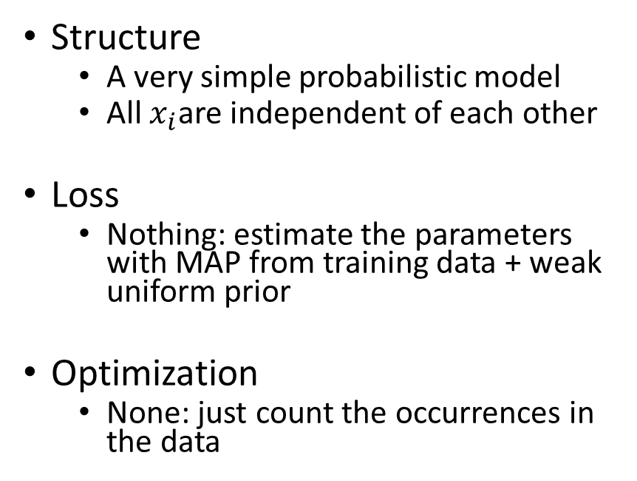
Naïve Bayes Summary
Overview
It is Good For
Structure
  A very simple probabilistic model
  All $x_{i}$are independent of each other
Loss
  Nothing: estimate the parameters with MAP from training data + weak uniform prior
Optimization
  None: just count the occurrences in the data
An introduction to
  Generative modeling
  Bayesian thought
  ML in general
In practice
  Nothing…
  (Maybe as a baseline)

